Slide 1
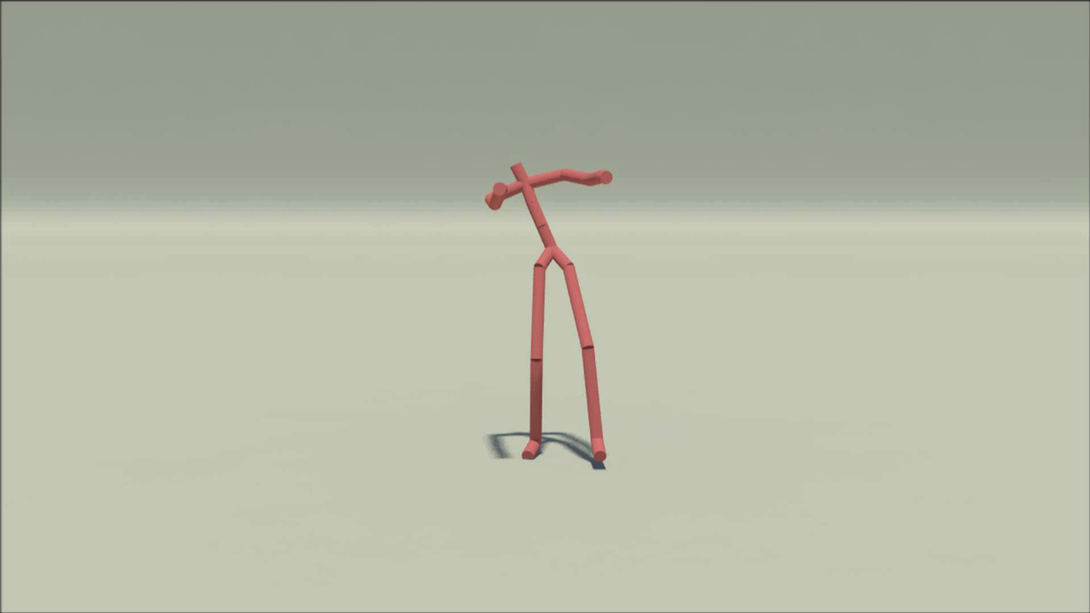
A Deep Learning Framework for Character Motion Synthesis and Editing (Holden et al.)
Nguyen THANH, 16 Sep 2016
AniAge

Slide 2
Outline
1 Algorithm
Overview
Motion database
Motion manifold training
Training feed-forward network: Parameter to motion
Disambiguation
2 Applications
Motion synthesis
Motion style transfer
3 Contribution

Slide 3
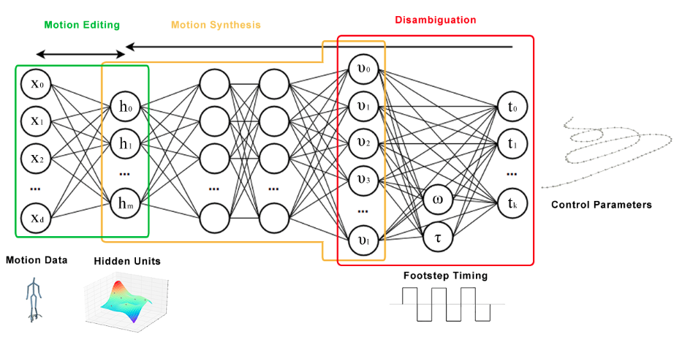
1.1 Overview
Motion manifold network
Feed-forward network
Disambiguation
network
High-level
parameters

Slide 4
1.2 Motion database
Source
Freely available online db of motion capture [CMU ; Mu ̈ller et al. 2007; Ofli et al. 2013; Xia et al. 2015]
Some internal captures.
Around 6 10⁶ frames, 120 fps of motion data for a single character
Normalization
Retargeting them to a uniform skeleton structure with a single scale and the same bone lengths

Slide 5
1.2 Motion database
Data format for training
Sub-sample motion in the database to 60 fps.
Subtracted by mean pose, divided by the standard deviation to normalize the scale of the character. The velocities, and contact labels are also divided by their own standard deviations.
Clip motion into fixed length of n (n = 240 in experiment), overlapped by n/2 frames. Clipping is just to boost the training speed, the model can train arbitrary length.

Slide 6


1.3 Training motion manifold
Input: Motion sequence X
Output: Motion manifold (network weights: theta = {wi, bi}) and hidden units H.
Method: Using convolutional auto-encoder to train network
Forward operation
Backward operation
Minimizing cost function using gradient descent
where: ReLU(x) = max(x, 0); psi max pooling function; convolutional operator *; theta = {W, b} ; alpha scale factor

Slide 7


1.4 Training feed-forward network T->X
Input: Parameter T (trajectory, bone length, position, etc.), is calculated directly from motion sequence X.
Output: A network maps T to X: phi = {w1, w2, w3, b1, b2, b3}
Method
Forward operation pai maps T to X:
Minimizing cost function by gradient descent
where: scale factor alpha; network phi; Parameter T; Motion X
Shortly, forward operation pai maps parameter T to hidden unit H; Then, inversed phi function inversed H to motion sequence Xhat; (X-Xhat)^2 is square root of difference.

Slide 8
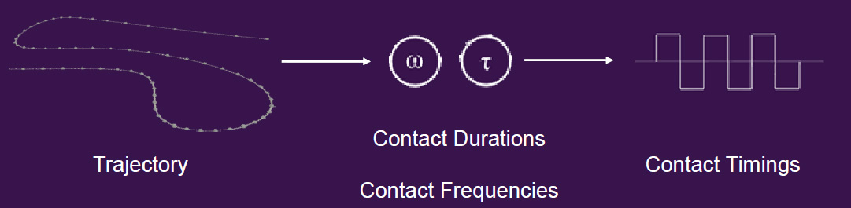
1.5 Disambiguation Problem, solution
High-level (low dimensional) parameters -> motion(high dimensional)
AMBIGUITY
Solution: A network to automatically compute foot contact timings from a given trajectory.

Slide 9
1.5 Disambiguation Training a disambiguation neural network
Input Motion sequences X
Output A neural network {w4, w5, b4, b5} to produce Contact Timings {T, F} from Trajectory T
Method
Defines foot contacts: F in {-1,1}^{nx4}, represents contact states of Left heel, Left toe, Right heel, Right toe at each frame.
Modelling F by Square waves
where (Omega, to) control the frequency and step duration at each frame, those are calculated from input motion X; a, b, c are scaling variables.

Slide 10
1.5 Disambiguation Training a disambiguation neural network
Method
Calculating F from input motion database X
Using gradient descent to train a two layers neural network {w4, w5, b4, b5}: T(calculated from X) - > F (calculated from X)
Forward operation

Slide 11



2.1 Motion synthesis: T -> X Generating motion X by defining high-level parameters T
Input: High-level parameter T, such as trajectory, position, etc.
Output: Motion sequence X satisfied T
Method
Initializing H
Minimizing cost function to find best H satisfied T using gradient descent.
Using inversed phi function to inverse found H to motion X

Slide 12
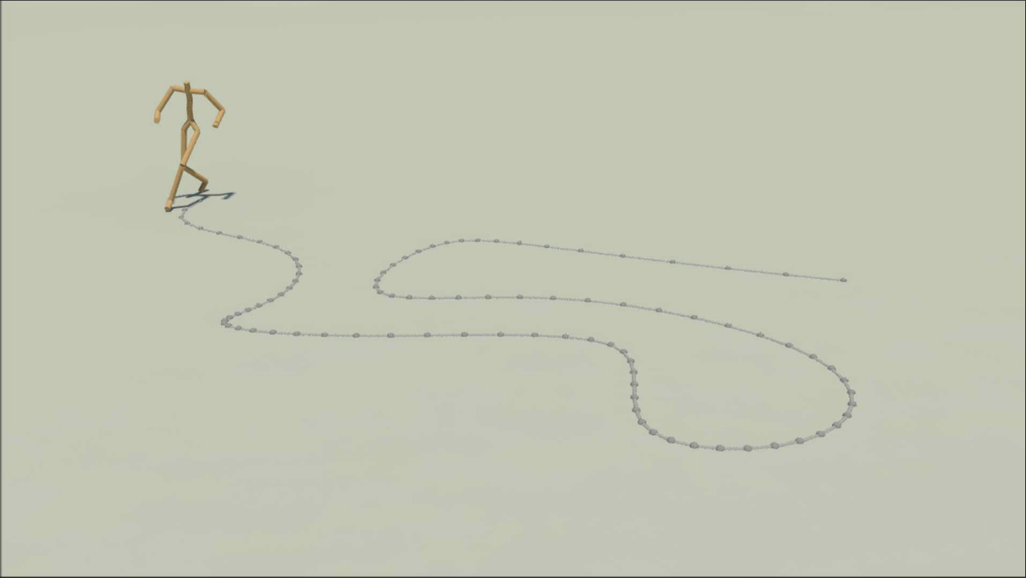
2.1 Motion synthesis: T -> X Generating motion X by defining high-level parameters T
T is the trajectory

Slide 13
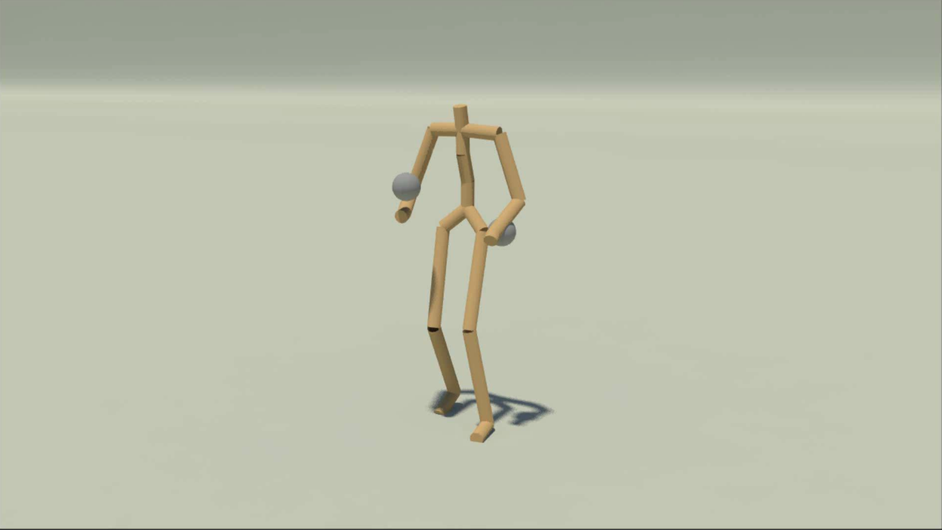
2.1 Motion synthesis: T -> X Generating motion X by defining high-level parameters T
T are some positions

Slide 14

2.2 Motion style transfer Transfer style of one motion to another motion
Input: Motion X_{S}, motion X_{C}
Output: Output motion X = content of X_{C} + style of X_{S}
Method
Using trained motion manifold to obtain hidden unit H_{S ,}H_{C} from X_{S} and X_{C} respectively.
Define style of a motion by Gram matrix of its hidden unit:
Using gradient descent to minimize cost function
Apply kinematic constraint to found H above to make motion natural.
Finally, using backward operation of trained motion manifold to inverse the found H to motion sequence X.

Slide 15
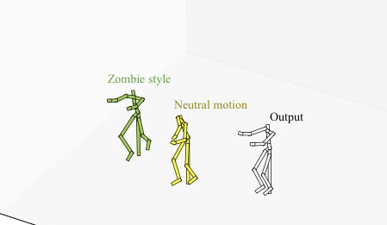
2.2 Motion style transfer Transfer style of one motion to another motion

Slide 16
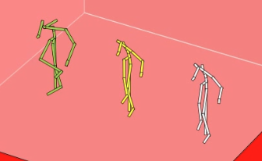
2.3 Motion De-noising De-nosing using trained motion manifolds
Green: Noised motion = 50% Original; Yellow: Reconstructed; White: Original

Slide 17
3. Contribution
Motion synthesizing from high-level parameters.
Motion style transfer.
Motion de-noising.

Slide 18
Thanks for listening
Q&A

